Slide 1

ADVANCED ALGORITHMS

Slide 2

ADVANCED ALGORITHMS
BASICS OF COMPLEXITY

Slide 3
ADVANCED ALGORITHMS
BASICS OF COMPLEXITY
Basics of Complexity - Road Map
Asymptotic Notations
Standard notations and common functions
Recurrences and Solution of Recurrence equations- Substitution method, Recurrence Tree method, Master method
Amortized Complexity Analysis: Aggregate, Accounting and Potential Methods.
NP-Completeness, NP Reduction

Slide 4
ADVANCED ALGORITHMS
BASICS OF COMPLEXITY
Amortized Analysis
Applicable for a sequence of operations, wherein some operations are expensive and others are inexpensive.
Asymptotic Analysis of algorithm- importance of Basic operation
In amortized analysis – average the time required to perform a sequence of data structure operations over all the operations performed.
Amortized analysis – Average cost of an operation is small even though a single operation within the sequence might be expensive

Slide 5
ADVANCED ALGORITHMS
BASICS OF COMPLEXITY
Amortized analysis
Probability is not used.
Average the cost, over a sequence of operations, even if some operation(s) is expensive.
Guarantees the average performance of each operation in the worst case.
Amortized analysis gives an upper-bound on the worst-case running time of a sequence of operations.

Slide 6
ADVANCED ALGORITHMS
BASICS OF COMPLEXITY
Methods of Aggregate Analysis
Aggregate Method: compute the total cost over n operations
(Total cost of n operations)/n
Accounting Method:
Assign each type of operation an amortized cost
Overcharge some operations
Store the overcharge as credit on specific objects, then use the credit for compensation for some later operations.

Slide 7
ADVANCED ALGORITHMS
BASICS OF COMPLEXITY
Methods of Aggregate Analysis
3. Potential Method:
Similar to accounting method, but more formal in nature.
Store the credit as “potential energy”.

Slide 8
ADVANCED ALGORITHMS
BASICS OF COMPLEXITY
Stack Operations
1. PUSH(S, x) takes O(1) time
2. POP(S) takes O(1) time
The total cost of a sequence of n PUSH and POP operations is n, and the actual running time for n operations is 𝚹(n).
x
y
x
y
x
x
Pop
Stack S
Push x
Push y

Slide 9
ADVANCED ALGORITHMS
BASICS OF COMPLEXITY
3. Multipop(S,k) takes min(s, k)
while not STACK-EMPTY(S) and k > 0
do POP(S)
k ← k - 1
What is the total cost of a sequence of n PUSH, POP and MULTIPOP operations in the worst-case?
z
y
x
w
x
w
x
w
Multipop(s,2)
Multipop(s,-2)
Multipop(s,10)
Empty Stack

Slide 10
ADVANCED ALGORITHMS
BASICS OF COMPLEXITY
Cursory Analysis of Stack operations
Let us consider a sequence of n PUSH, POP, MULTIPOP.
worst-case cost of PUSH and POP are O(1)
worst-case cost of MULTIPOP is O(n) for a stack size of n. Because the stack size can grow up to a size of O(n) during n operations, MULTIPOP takes O(n) time in the worst-case.
So, worst-case cost of an operation is O(n).
Thus the cost of the sequence of n operations is O(n²) and O(n) is the cost/operation in the worst-case.
The cursory analysis is correct, but not tight!! Intuitively, isn’t it O(1)? For that we need to prove that a sequence of n operations on an initially empty stack cost at most O(n).

Slide 11
ADVANCED ALGORITHMS
BASICS OF COMPLEXITY
Amortized Analysis: Aggregate Method
To prove that a sequence of n operations on an initially empty stack cost at most O(n).
Each object can be POPped only once (including in MULTIPOP) for each time it is PUSHed
Number of POPs is at most equal to the number of PUSHes, which is at most = n.
Number of PUSHes and POPs = 2(n) = O(n).
Thus the average worst-case cost of an operation when a sequence n operations are performed is O(n)/n = O(1).

Slide 12
ADVANCED ALGORITHMS
BASICS OF COMPLEXITY
Amortized Analysis: Accounting Method
Assign differing charges to different operations.
The amount of the charge is called amortized cost.
Amortized cost may be more or less than Actual cost of an operation.
When Amortized cost > Actual cost, the difference is saved as Credits.
The credits can be used by later operations whose Amortized cost < Actual cost.
At any point of time the
total amortized cost ≥ total actual cost.

Slide 13
ADVANCED ALGORITHMS
BASICS OF COMPLEXITY
Accounting Method: Stack
Actual costs: PUSH: 1, POP: 1, MULTIPOP: min(s, k).
Assign the following amortized costs:
PUSH:2, POP: 0, MULTIPOP: 0.
Suppose ₹1 represents a unit cost.
When pushing a item, use ₹1 to pay the actual cost of the push and leave ₹1 on the item as credit.
Whenever POPing a item, the ₹1 on the item is used to pay the actual cost of the POP. (same for MULTIPOP).
By charging PUSH a little more, do not charge POP and MULTIPOP.

Slide 14
ADVANCED ALGORITHMS
BASICS OF COMPLEXITY
Accounting Method: Stack
Actual costs: PUSH: 1, POP: 1, MULTIPOP: min(s, k).
Assign the following amortized costs:
PUSH:2, POP: 0, MULTIPOP: 0.
The total amortized cost for n PUSH/POP/MULTIPOP is 2n ∈ O(n), thus O(1) for amortized cost for each operation.

Slide 15
ADVANCED ALGORITHMS
BASICS OF COMPLEXITY
Amortized Analysis: Potential Method
Similarity with Accounting method: prepaid is used later.
Differs from accounting method
The prepaid charge not as credit, but as “Potential energy”.
The potential is associated with the data structure as a whole rather than with specific objects within the data structure

Slide 16
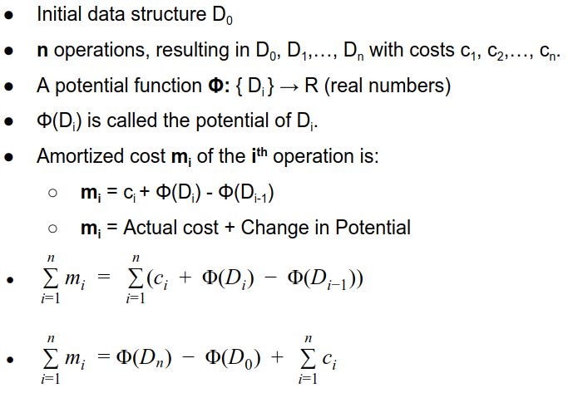
ADVANCED ALGORITHMS
BASICS OF COMPLEXITY

Slide 17
ADVANCED ALGORITHMS
BASICS OF COMPLEXITY
Amortized Analysis: Potential Method
If Φ(D_{n}) ≥ Φ(D₀), then total amortized cost is an upper bound of total actual cost.
Φ(D_{i}) ≥ Φ(D₀) is required for any i.
It is convenient to make Φ(D₀) = 0, and Φ(D_{i}) ≥ 0, for all i to satisfy Φ(D_{i}) ≥ Φ(D₀).
If the potential change is positive (i.e., Φ(D_{i}) - Φ(D_{i-1}) > 0), then m_{i} is an overcharge.
If the potential change is negative, then m_{i} is an undercharge (discharge the potential to pay the actual cost).

Slide 18
ADVANCED ALGORITHMS
BASICS OF COMPLEXITY
Potential method : Stack
Let Potential function Φ(D_{i}) be the number of objects in the stack after i^{th} operation.
Φ(D₀) = 0, and Φ(D_{i}) ≥ 0
Amortized cost of stack operations:
PUSH: Potential change: Φ(D_{i}) - Φ(D_{i-1}) = (s+1) - s = 1.
Amortized cost: m_{i} = c_{i} + Φ(D_{i}) - Φ(D_{i-1}) = 1+1 = 2.
POP: Potential change: Φ(D_{i}) - Φ(D_{i-1}) = (s-1) - s = -1.
Amortized cost: m_{i} = c_{i} + Φ(D_{i}) - Φ(D_{i-1}) = 1 + (-1) = 0.
MULTIPOP(S,k): Let k' = min(s, k)
Potential change: Φ(D_{i}) - Φ(D_{i-1}) = - k'.
Amortized cost: m_{i} = c_{i} + Φ(D_{i}) - Φ(D_{i-1}) = k' + (-k' ) = 0.

Slide 19
ADVANCED ALGORITHMS
BASICS OF COMPLEXITY
Potential method : Stack
Amortized cost of stack operations:
PUSH: Amortized cost: 2.
POP: Amortized cost: 0.
MULTIPOP(S,k): Amortized cost: 0.
So amortized cost of each operation is O(1), and total amortized cost of n operations is O(n).
Since total amortized cost is an upper bound of actual cost, the worse-case cost of n operations is O(n).

